Slide 1
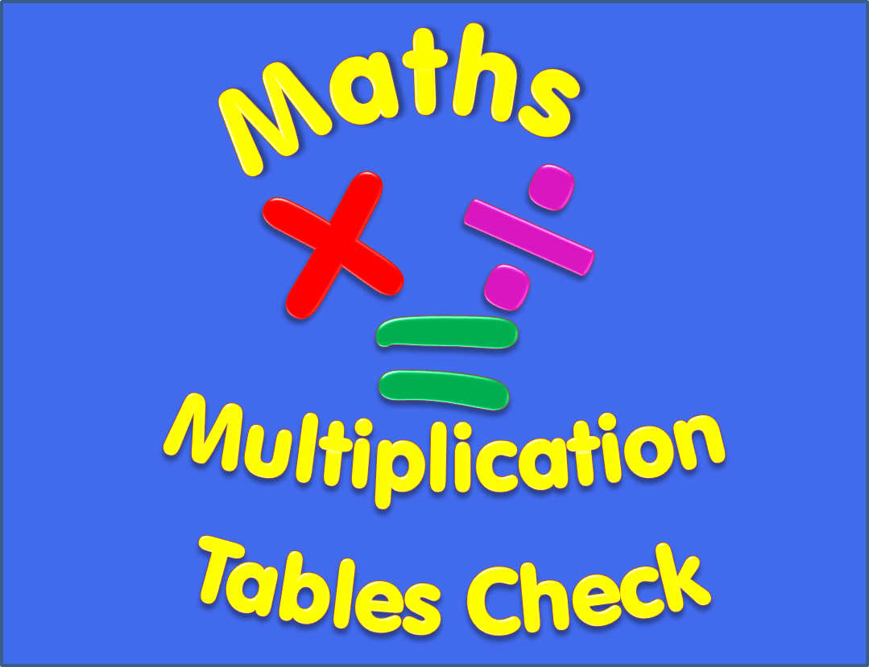

Slide 2
Begin
Instructions
There are 25 multiplication questions on any times table from 2 to 12.
Each multiplication question will appear on the screen for 6 seconds. There will then be a 3 second break before the next question appears.
Good Luck!

Slide 3
4 x 8
Q1

Slide 4
10 x 9
Q2

Slide 5
12 x 6
Q3

Slide 6
6 x 10
Q4

Slide 7
5 x 5
Q5

Slide 8
6 x 9
Q6

Slide 9
12 x 4
Q7

Slide 10
8 x 8
Q8

Slide 11
5 x 10
Q9

Slide 12
11 x 6
Q10

Slide 13
3 x 8
Q11

Slide 14
2 x 2
Q12

Slide 15
8 x 9
Q13

Slide 16
12 x 11
Q14

Slide 17
6 x 7
Q15

Slide 18
11 x 7
Q16

Slide 19
6 x 4
Q17

Slide 20
3 x 7
Q18

Slide 21
7 x 6
Q19

Slide 22
12 x 7
Q20

Slide 23
8 x 5
Q21

Slide 24
7 x 4
Q22

Slide 25
9 x 9
Q23

Slide 26
10 x 4
Q24

Slide 27
11 x 11
Q25

Slide 28
Completed!
All multiplication questions have now been shown.
To find out your score click on the button below.
Answers

Slide 29
Answers
1) 4 x 8 = 32 2) 10 x 9 = 90 3) 12 x 6 = 72
4) 6 x 10 = 60 5) 5 x 5 = 25 6) 6 x 9 = 54
7) 12 x 4 = 48 8) 8 x 8 = 64 9) 5 x 10 = 50
10) 11 x 6 = 66 11) 3 x 8 = 24 12) 2 x 2 = 4
13) 8 x 9 = 72 14) 12 x 11 = 132 15) 6 x 7 = 42
16) 11 x 7 = 77 17) 6 x 4 = 24 18) 3 x 7 = 21
19) 7 x 6 = 42 20) 12 x 7 = 84 21) 8 x 5 = 40
22) 7 x 4 = 28 23) 9 x 9 = 81 24) 10 x 4 = 40
25) 11 x 11 = 121

